Slide 1
Stop Phishing Scam Email
5 Tips for a simpler way to work

Slide 2
What is ‘Phishing’?
Phishing is a form of fraud in which an attacker masquerades as a reputable entity or person in email or other forms of communication. Attackers will commonly use phishing emails to distribute malicious links or attachments that can perform a variety of functions. Some will extract login credentials or account information from victims.
01.

Slide 3
What to watch for.
Any email that asks you to call a customer service call center. The fake call center representative could try to make you download malicious software to your computer
Any request to call an unfamiliar phone number to confirm or dispute an invoice, or resolve a cloud provider subscription or maintenance issue
You may not always see a link or attachment in a phishing email, but it still can be a malicious email
02.

Slide 4
Additional tips for
identifying phishing emails
01
Look at the sender's name and email address and assess if it is an attempt to imitate someone you know and trust. Cybercriminals are using online research to make their phishing emails more personal and effective.
02
Is the email personal?
Do you know the sender?
02
If the sender addresses you as a 'customer', 'friend', 'colleague' or another non-specific designation, be very suspicious of the email content.
01
Does the email contain an urgent threat?
03
If the email contains a link, an attached document, or a request, think carefully before you act.
03
Does the sender require an action?
04
04
Threats or instructions to act quickly in order to avoid unpleasant consequences are well-known tactics to get us to act before we think.

Slide 5
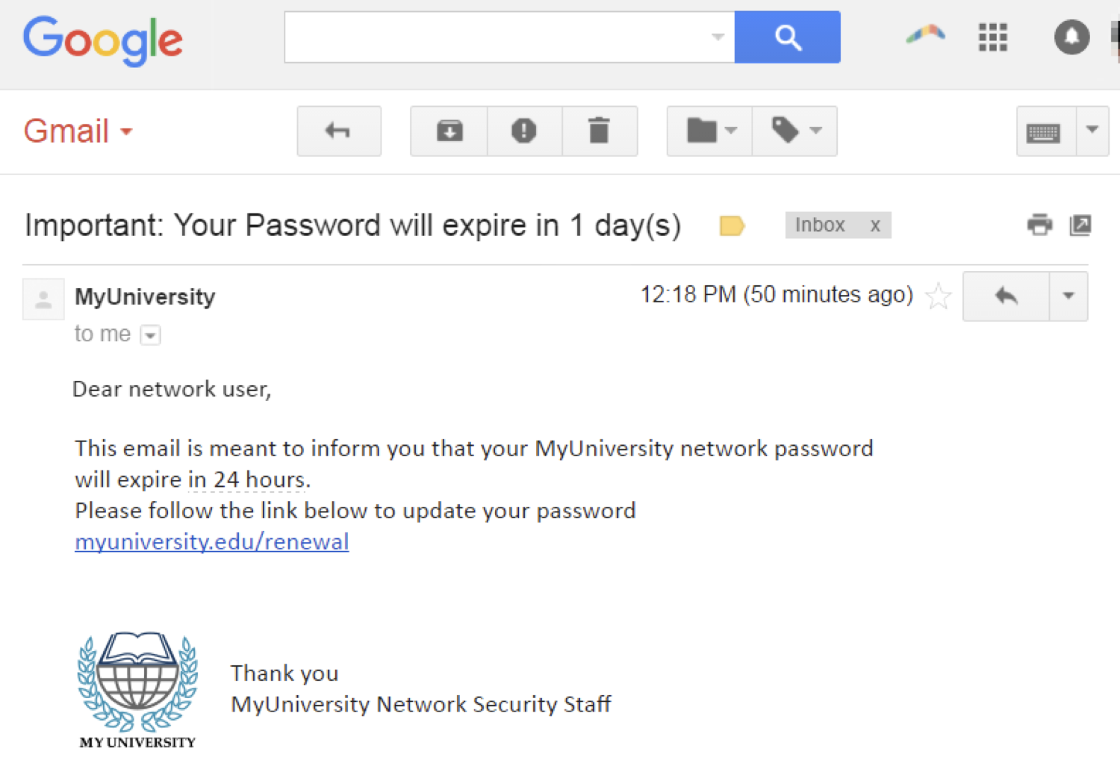
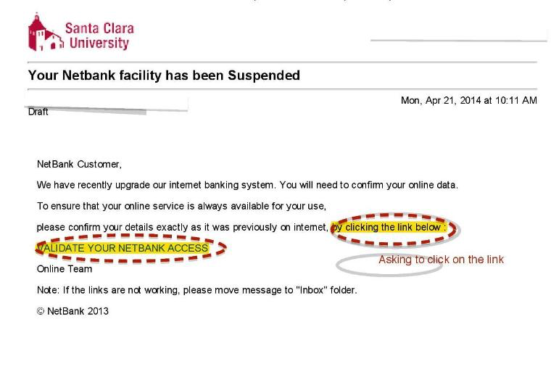
Example.

Slide 6
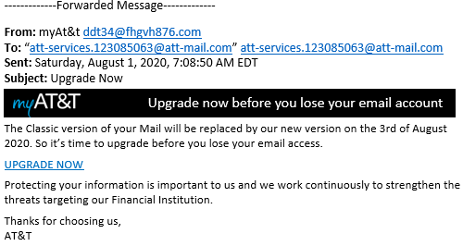
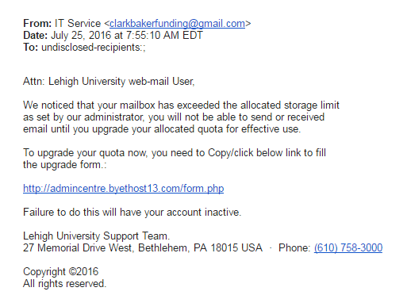
Example.

Slide 7
03.
Solution.
Our cybersecurity teams constantly monitor threat intelligence and the network for malicious activity, and we are committed to keeping you informed. Every professional can help protect client data, company data, and personal information by staying alert and aware.

Slide 8
Solution.
Treat any messages like the examples as a threat and report it immediately. Our company Contact Center will never email you to set up a call, nor will they have you download software to your company equipment via a call.
In addition, once you have reported a suspicious email, there are some considerations and next steps to protect yourself.

Slide 9
Solution.
Regarding the suspicious email, if you have: | Take action:
Opened a link or attachment, and believe your computer is infected or account has been compromised. | Disconnect from the internet then immediately call the help desk for guidance and support.
Entered your company username and/or password after opening a link or attachment. | Change your Deloitte password then immediately call the help desk for guidance and support.
Replied to the suspicious email or communicated with the sender or; Provided company, client, or personal information. | Immediately call the help desk for guidance and support. If you provided company, client, or personal information – report the data loss to the help desk to allow company to respond to it in an appropriate way.

Slide 10
Thank you

